Slide 1


People Detection using
Yolo v4-tiny detector
Atoki Bolutife, Tamás Bukits

Slide 2
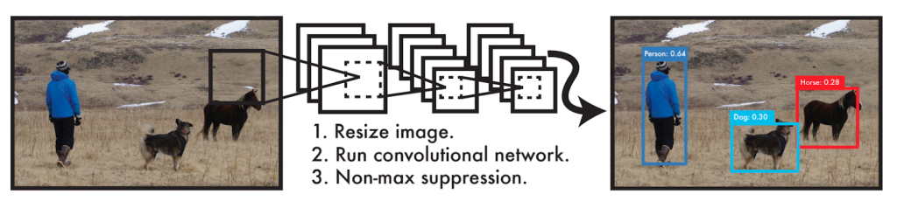
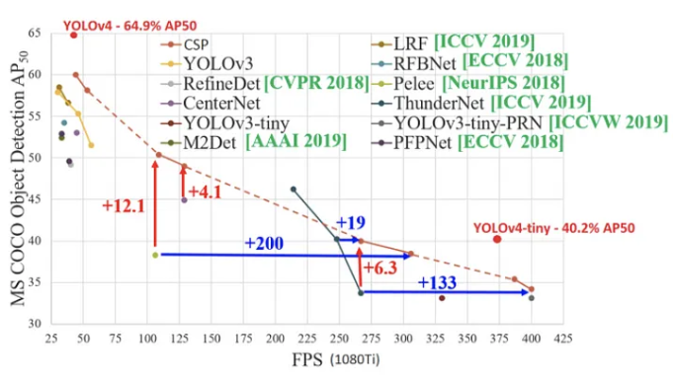
Yolo v4-tiny detector
29 pre-trained convolutional layers instead of 129
8 times faster than Yolo v4 using in real time applications (e.g.: mobile phone) with not losing accuracy

Slide 3
Results at Initial Submission
Name of the sequence | DTDP detector | Yolo v4-tiny detector
Overpass | 84.47 | 91.03
Fall | 13.83 | 19.07
Badminton | 74.13 | 79.31
AbandonedBox | 4.42 | 49.23
Backdoor | 91.63 | 97.12
BusStation | 85.23 | 87.39
CopyMachine | 51.14 | 85.91
Cubicle | 70.91 | 92.47
Office | 96.82 | 99.85

Slide 4
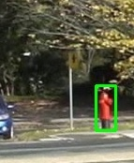
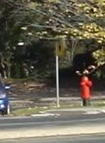
Improvement 1 considered
Thresholding using boundary box height and width to filter fire hydrant and other false detections
18
38
Fall (Before)
Fall (After)

Slide 5
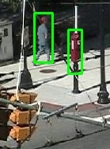
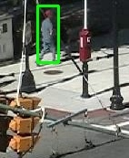
Improvement 2 considered
False detection reduction by thresholding using boundary box diagonal
w
(W² + H²)^{0.5}
H
Abandoned Box (Before)
Abandoned Box (After)
Bounding Box

Slide 6
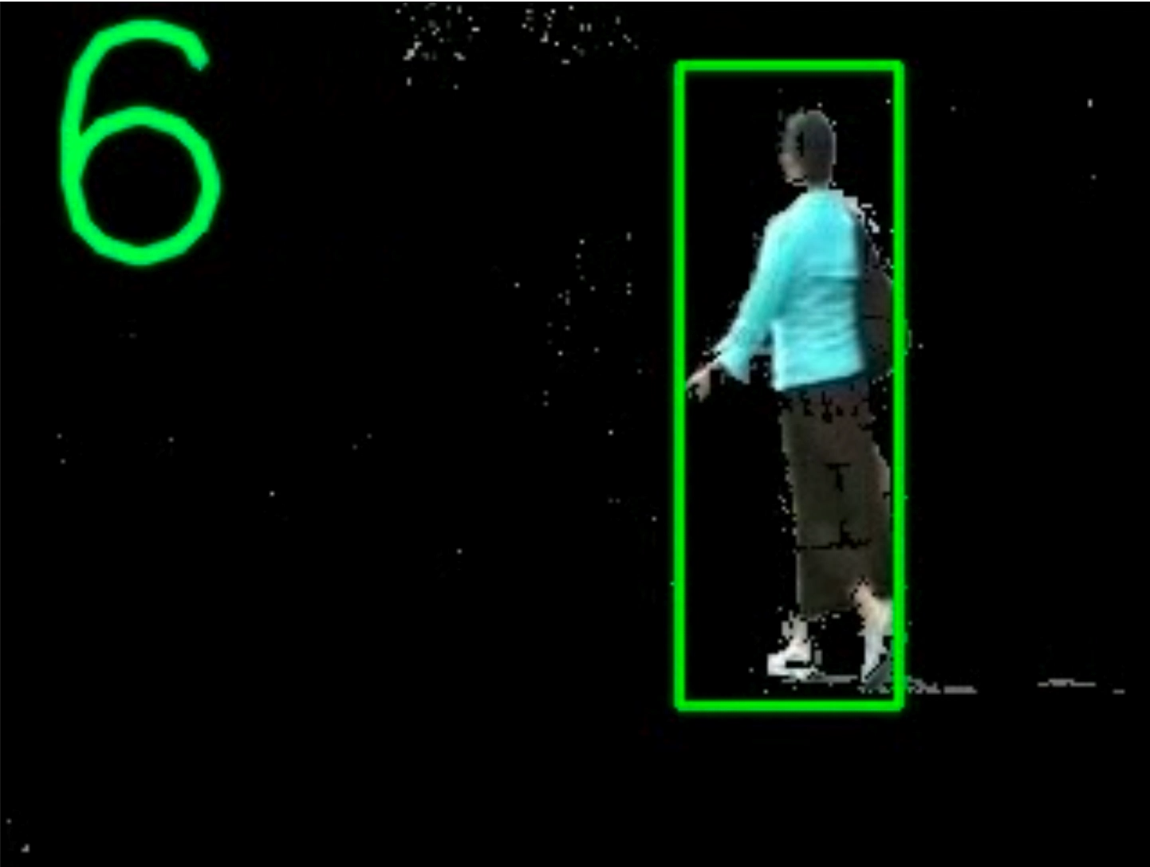
Improvement Implemented
Initial Foreground Segmentation before Detection
Creating a foreground mask using MOG2
Replacing foreground mask with frame pixels
Backdoor Sequence

Slide 7
Results after implementing Foreground Segmentation
Name of the sequence | DTDP detector | Yolo v4-tiny detector | Foreground Seg + Yolo v4-tiny detector | % Changes
Overpass | 84.47 | 91.03 | 83.73 | -8.01%
Fall | 13.83 | 19.07 | 49.52 | +159%
Badminton | 74.13 | 79.31 | 74.38 | -6.2%
AbandonedBox | 4.42 | 49.23 | 17.19 | -65.08%
Backdoor | 91.63 | 97.12 | 82.93 | -14.61%
BusStation | 85.23 | 87.39 | 67.03 | -23.29%
CopyMachine | 51.14 | 85.91 | 54.92 | -36.07%
Cubicle | 70.91 | 92.47 | 77.42 | -16.27%
Office | 96.82 | 99.85 | 49.52 | -50.40%

Slide 8
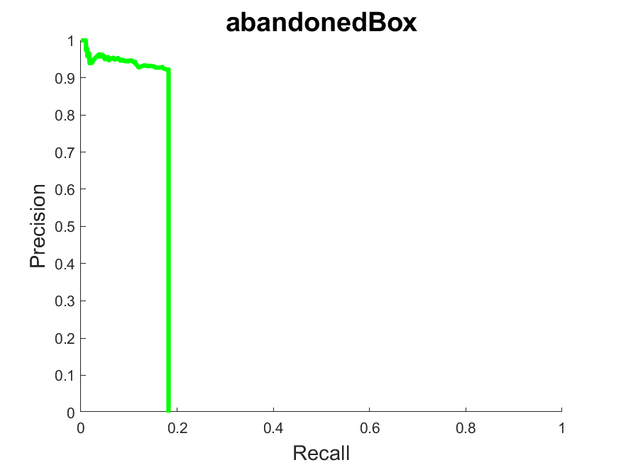
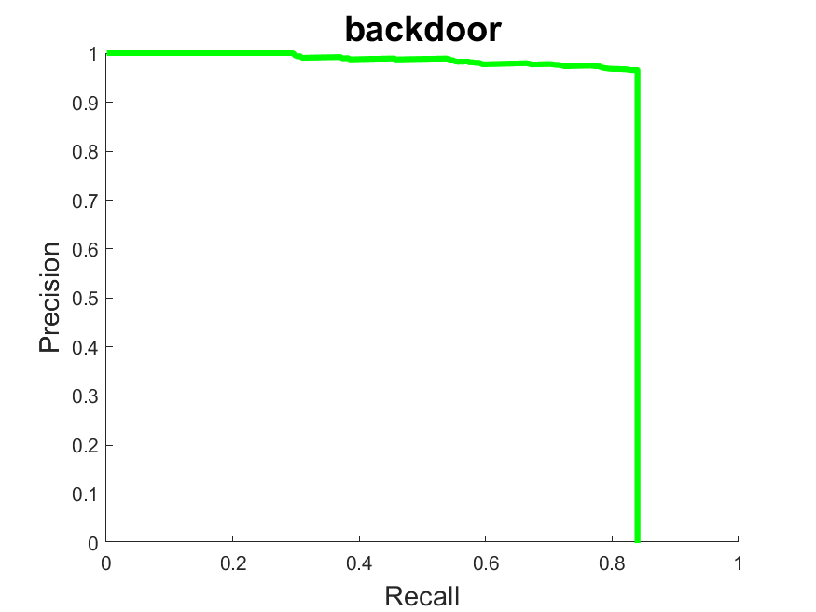
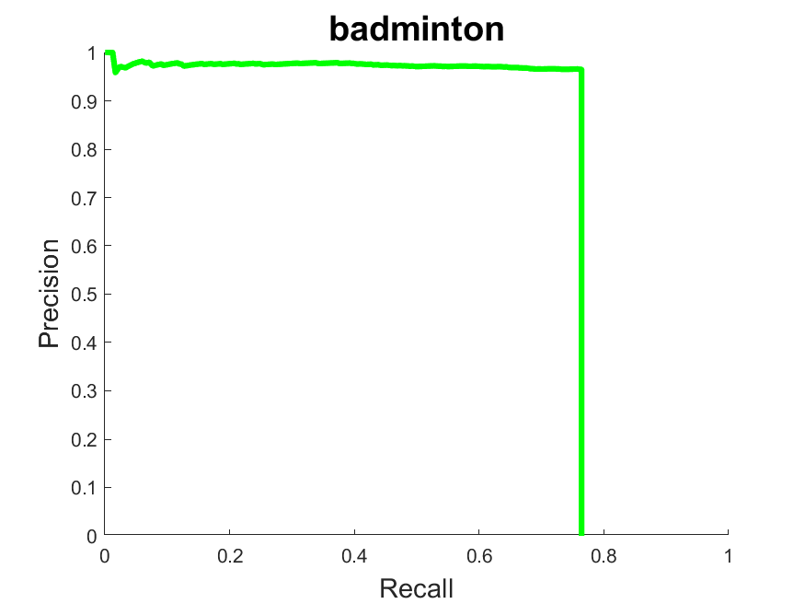
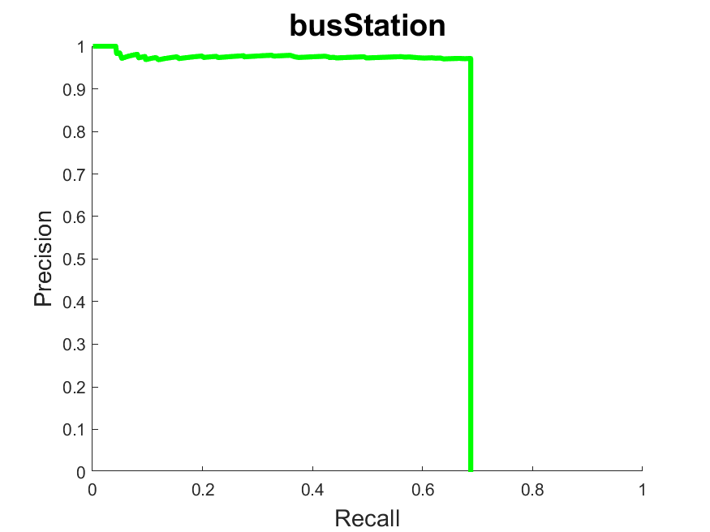
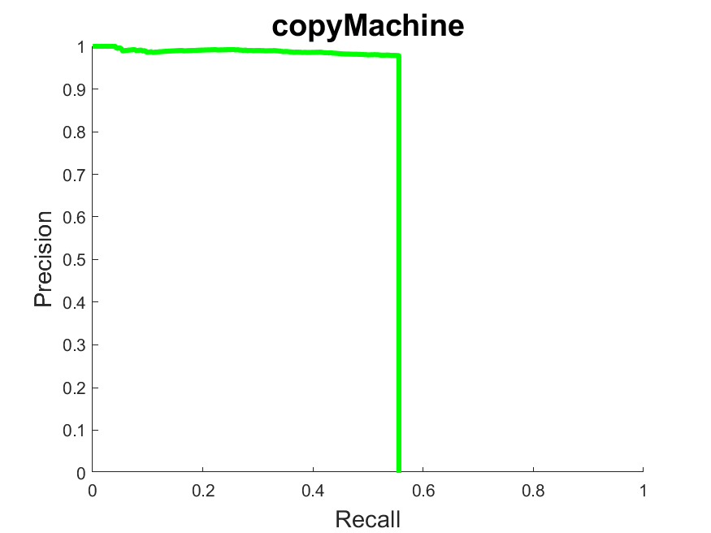
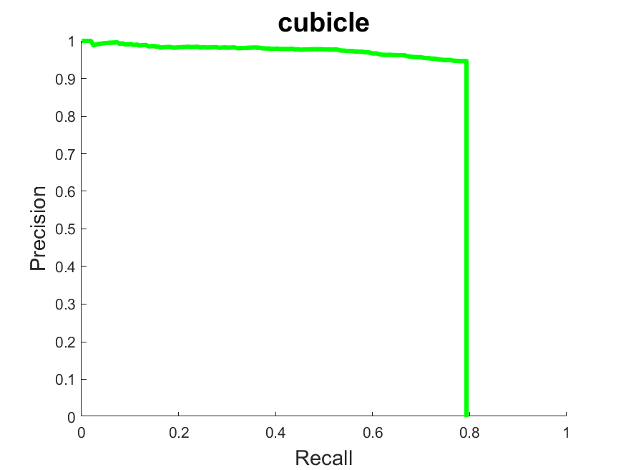
Precision-Recall curves
Abandoned Box AUC: 17.19
Backdoor AUC: 82.93
Badminton AUC: 74.38
BusStation AUC: 67.03
CopyMachine AUC: 54.92
Cubicle AUC: 77.42

Slide 9
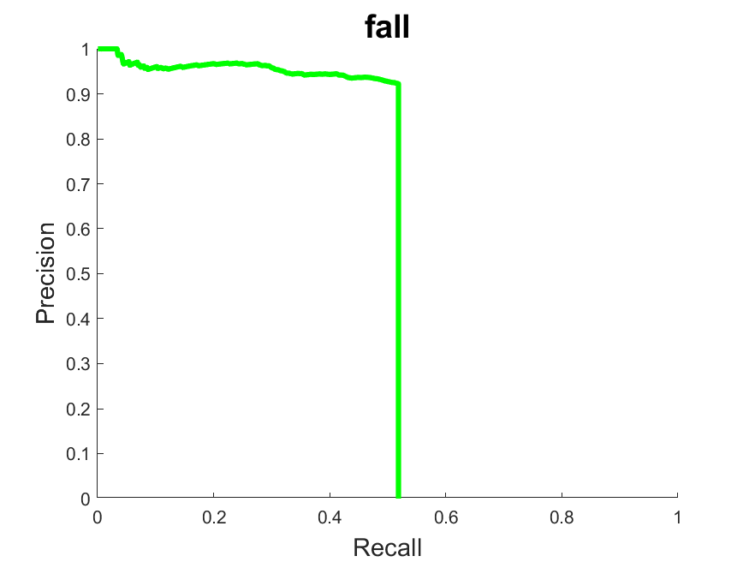
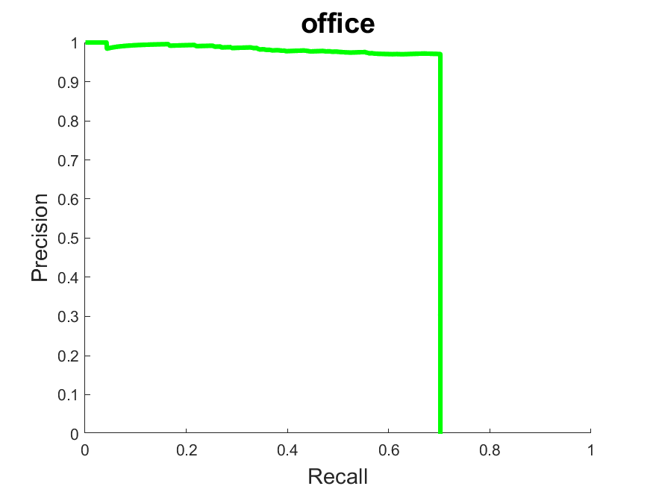
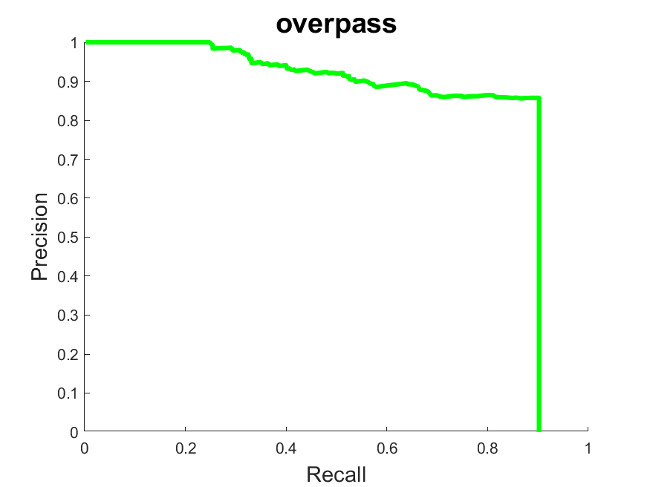
Precision-Recall curves continued
Fall AUC: 49.52
Office AUC: 68.97
Overpass AUC: 83.73
9

Slide 10
Thank you!
10

